Slide 1
Regularizations
Dropout
Call backs
Batch Normalizations
Weight Initializations

Slide 2
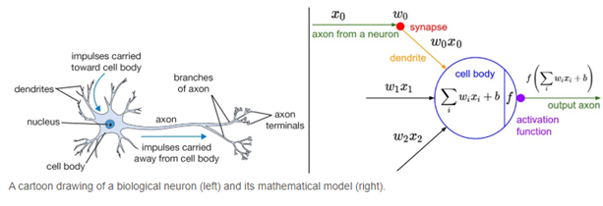
What is a Neural Network Activation Function?
An Activation Function decides whether a neuron should be activated or not. This means that it will decide whether the neuron’s input to the network is important or not in the process of prediction using simpler mathematical operations.
The role of the Activation Function is to derive output from a set of input values fed to a node (or a layer).
Activation functions play a crucial role in neural networks by introducing non-linearity, enabling the model to learn and represent complex patterns. Without activation functions, a neural network behaves like a linear model, limiting its ability to capture intricate relationships in data.

Slide 3
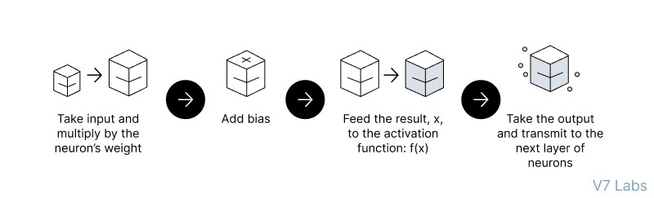
Feedforward Neural Networks (FNN):
the flow of information occurs in the forward direction. The input is used to calculate some intermediate function in the hidden layer, which is then used to calculate an output.
2. Backpropagation
- the weights of the network connections are repeatedly adjusted to minimize the difference between the actual output vector of the net and the desired output vector.
Implement the FNN
https://colab.research.google.com/drive/1z_nL3RcvR1x4uIR88VWEj8Zdr7mYEcQK#scrollTo=keCSdzvOrRmx

Slide 4
Regularizations

Slide 5
Dropout

Slide 6
Call backs
Model Checkpoint
Early stoping

Slide 7
Batch Normalizations

Slide 8
Weight Initializations
Xavier/Glorat And He Weight Initialization in Deep Learning
Exponentially Weighted Moving Average or Exponential Weighted Average

Slide 9
Model Expainlibility
LIME
SHAPY

Slide 10
HyperParameter tuning
keras tunier

